Slide 1

Web and Cloud Security
Department of Economic Informatics and Cybernetics
Bucharest University of Economic Studies
ASP.NET MVC Core – Part I
Liviu-Adrian Cotfas, PhD.
liviu.cotfas@ase.ro

Slide 2

ASP.NET MVC Core, C# Language
url: https://docs.microsoft.com/en-us/aspnet/core
C#

Slide 3

About me
https://ro.linkedin.com/in/cotfasliviu

Slide 4
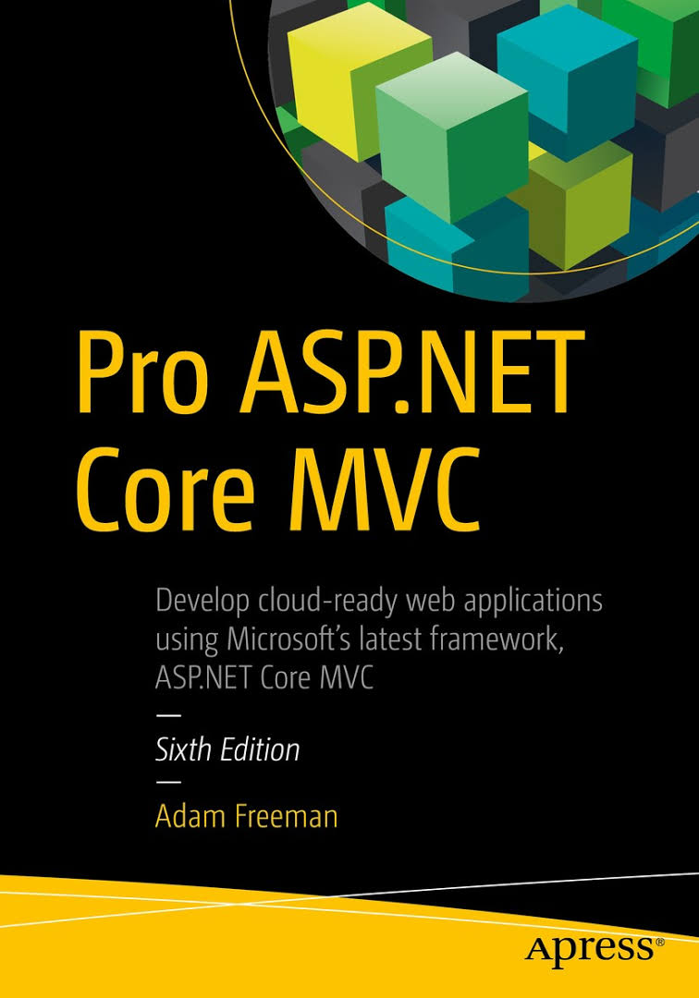
Administrative issues
Recommended Reading / Watching
Pro ASP.NET Core MVC
ADAM FREEMAN
Now in its 6th edition, the best selling book on MVC is now updated for ASP.NET Core MVC.
http://www.apress.com/us/book/9781484203989
https://github.com/apress/pro-asp.net-core-mvc

Slide 5
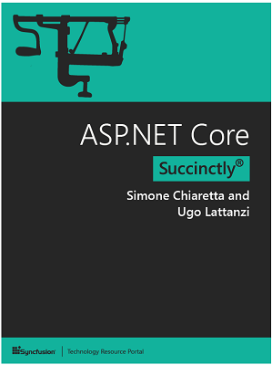
Administrative issues
Recommended Reading / Watching
ASP.NET Core Succinctly (Free)
Simone Chiaretta and Ugo Lattanzi
In ASP.NET Core Succinctly, seasoned authors Simone Chiaretta and Ugo Lattanzi update you on all the advances provided by Microsoft’s landmark framework.
https://www.syncfusion.com/resources/techportal/details/ebooks/ASP_NET_Core_Succinctly

Slide 6
Administrative issues
Further Reading / Watching
Courses on Microsoft Virtual Academy - mva.microsoft.com
Free
Courses on PluralSight - www.pluralsight.com
Free trial
Free access (limited period) through Microsoft DreamSpark

Slide 7
Administrative issues
API reference and Source code
Documentation:
https://docs.microsoft.com/en-us/aspnet/core/
API reference:
https://docs.microsoft.com/en-us/aspnet/core/api/
Source code:
https://github.com/aspnet/Home
Various samples:
https://code.msdn.microsoft.com/

Slide 8
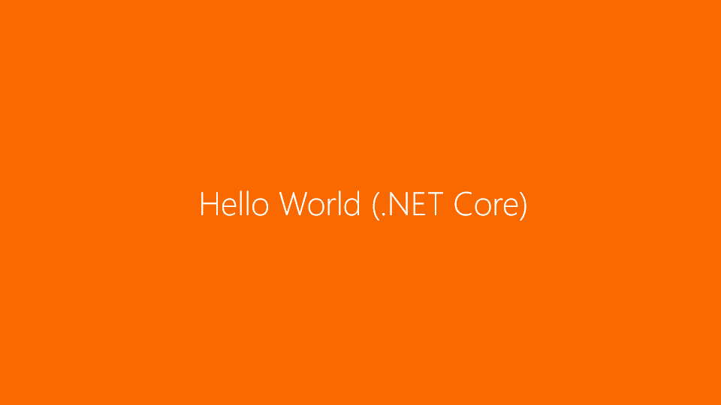
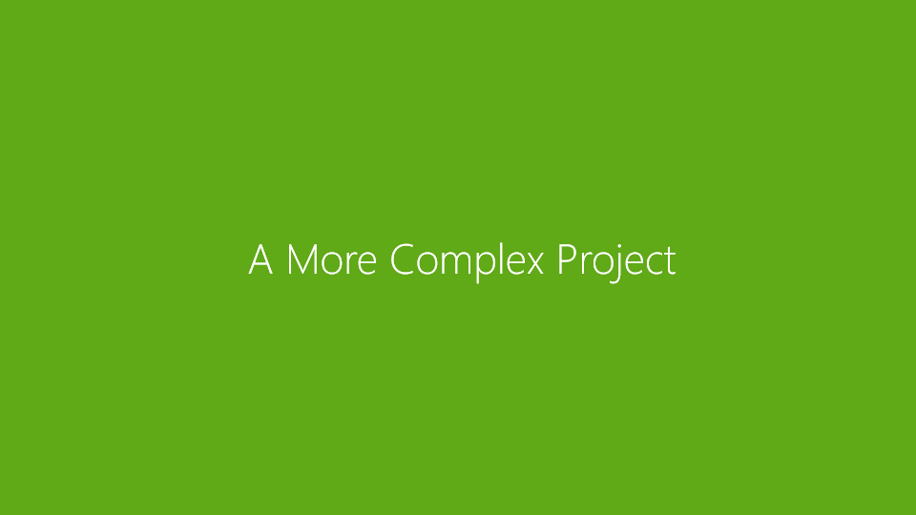

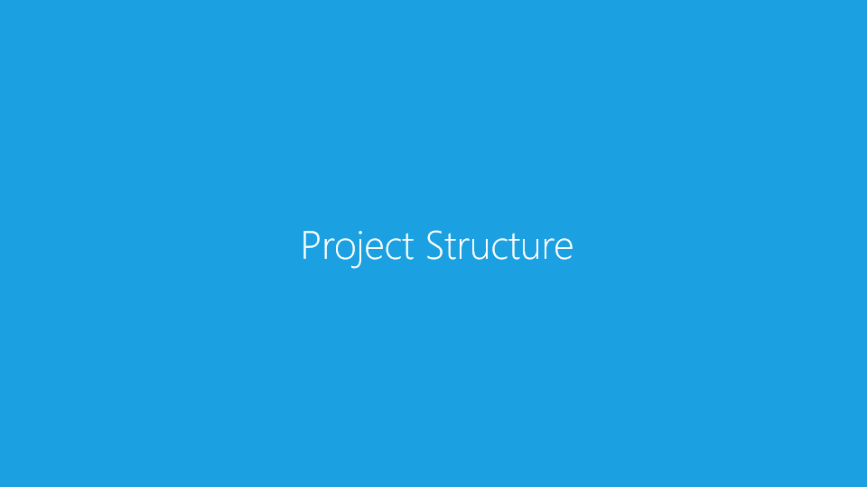
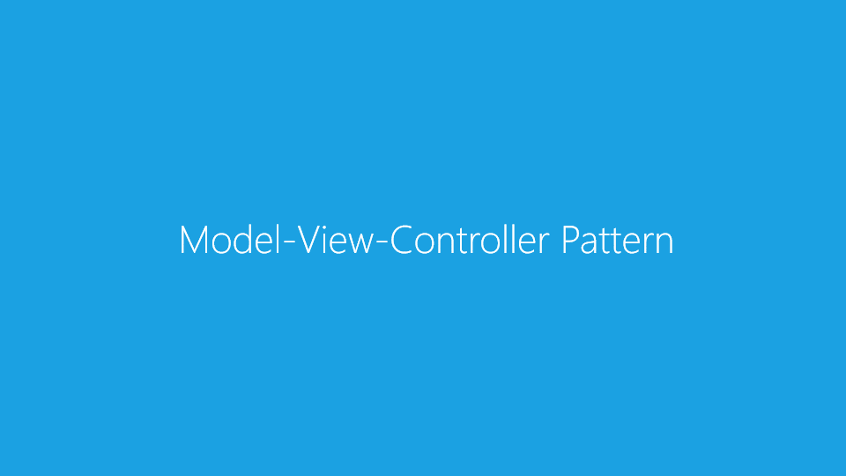
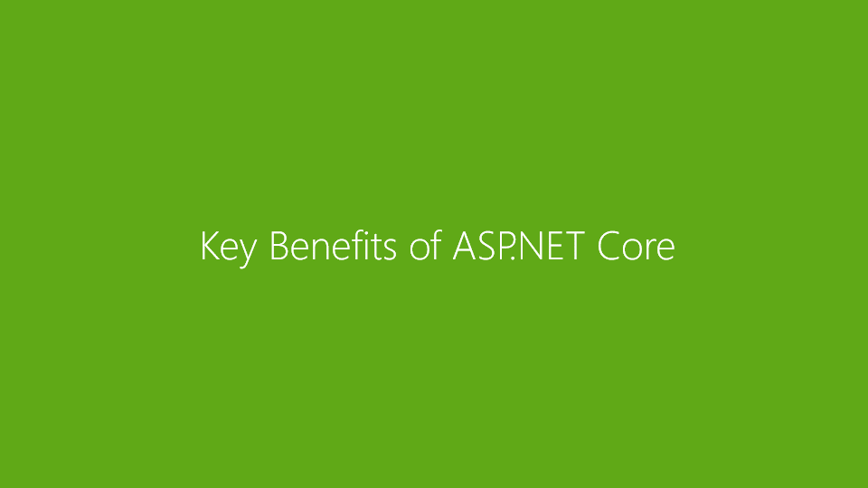
Contents

Slide 9
Brief History of the Microsoft Web Stack

Slide 10
Brief History of the Microsoft Web Stack
ASP.NET Web Forms
Shortcomings ASP.NET Web Forms :
View State weight: The actual mechanism for maintaining state across requests (known as View State) resulted in large blocks of data being transferred between the client and server. This data could reach hundreds of kilobytes in even modest web applications, and it went back and forth with every request, leading to slower response times and increasing the bandwidth demands of the server.
Page life cycle: The mechanism for connecting client-side events with server-side event handler code, part of the page life cycle, could be complicated and delicate. Few developers had success manipulating the control hierarchy at runtime without creating View State errors or finding that some event handlers mysteriously fail to execute.

Slide 11
Brief History of the Microsoft Web Stack
ASP.NET Web Forms
Limited control over HTML: Server controls rendered themselves as HTML, but not necessarily the HTML you wanted. In early versions of ASP.NET, the HTML output failed to meet with web standards or make good use of Cascading Style Sheets (CSS), and server controls generated unpredictable and complex ID attributes that are hard to access using JavaScript. These problems have improved in recent Web Forms releases, but it can still be tricky to get the HTML you expect.
Low testability : The designers of Web Forms could not have anticipated that automated testing would become an essential component of software development. The tightly coupled architecture they designed was unsuitable for unit testing. Integration testing could be a challenge, too.

Slide 12
Brief History of the Microsoft Web Stack
ASP.NET MVC
Launched in 2007 (CTP), 2009 (1.0);
Based on the Model-View-Controller (MVC) pattern to keep a clear separation between business logic and presentation logic, allowing complete control over the HTML markup.
Released as a separate library, one not included in the framework. Thanks to this release model, and not relying 100% on the IDE for the design of the UI, it was possible to easily update it, keeping it more in line with the fast-paced world of web development.

Slide 13
Brief History of the Microsoft Web Stack
ASP.NET MVC
Although solving the problem of the slow release cycle and removing the HTML markup abstraction, ASP.NET MVC still suffered from:
One couldn't run .NET applications on a non-Windows system.
The dependency on the full framework made the .NET apps less suitable for high-density scenarios, like the cloud, where hundreds of applications run on a single machine and must scale up very fast.
The complexity of the .NET project system prevented the development of .NET apps outside of Visual Studio.

Slide 14
Brief History of the Microsoft Web Stack
ASP.NET Core
built on .NET Core, which is a cross-platform version of the .NET Framework without the Windows-specific application programming interfaces (APIs).
possible for developers to create ASP.NET Core web applications on Linux and OS X/macOS.
ASP.NET Core is a completely new framework. It is simpler, it is easier to work with, and it is free of the legacy that comes from Web Forms. And, since it is based on .NET Core, it supports the development of web applications on a range of platforms and containers.

Slide 15
Brief History of the Microsoft Web Stack
ASP.NET Core
provides the functionality of the original ASP.NET MVC Framework and includes the functionality that was previously provided by Web API.

Slide 16
Hello World (.NET Core)

Slide 17
First application
Installing Visual Studio 2017
Visual Studio 2017 is available in Community, Professional and Enterprise editions.
Community is available for free and has all of the features required for day-to-day development. Download and run the installer from www.visualstudio.com
Professional is available through microsoft.ase.ro
During setup make sure that you select the .NET Core Cross-Platform Development workload.

Slide 18
First application
Installing Visual Studio 2017

Slide 19
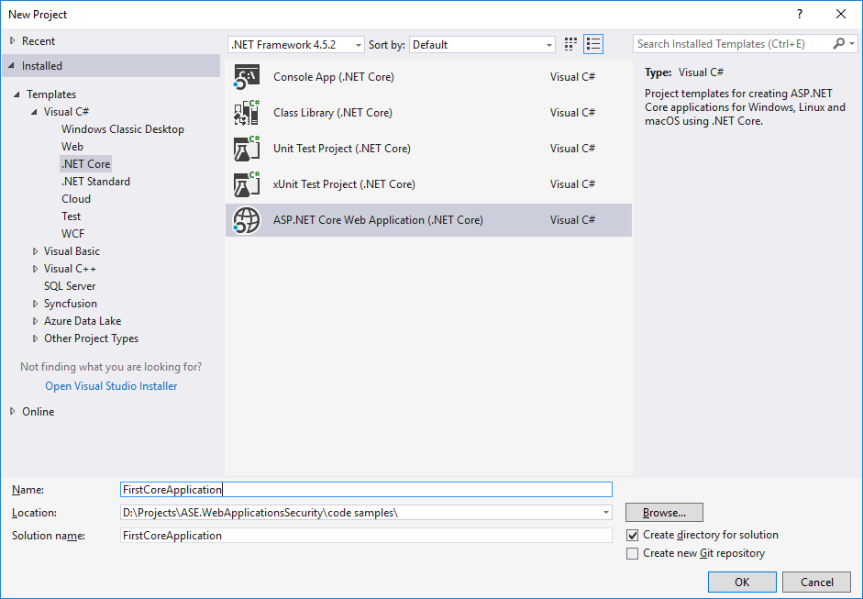
First application
New Project

Slide 20
First application
Why use C#?
C# (pronounced "C sharp") is a general-purpose, type-safe language, object-oriented programming language, designed for building a variety of applications
Focused on developer productivity.
C# syntax is based on the C & C++ syntax.
Platform-neutral, but it was written to work well with the Microsoft .NET Framework.
Notes:
C# is primarily a type-safe language: for instance, C# prevents you from interacting with a string type as though
it were an integer type.
(and strongly typed)

Slide 21

First application
Demo
https://github.com/liviucotfas/ase-web-and-cloud-applications-security/blob/master/FirstCoreApplication.md

Slide 22
Key Benefits of ASP.NET Core

Slide 23
Key Benefits of ASP.NET Core
MVC Architecture
implements the MVC pattern and, in doing so, provides a greatly improved
separation of concerns when compared to Web Forms.

Slide 24
Key Benefits of ASP.NET Core
Extensibility
ASP.NET Core is built as a series of independent components that have well-defined characteristics, satisfy a .NET interface or that are built on an abstract base class. Thus, it is possible to replace key components with ones of your own implementation.
In general, the ASP.NET Core MVC gives you these three options for each component:
Use the default implementation of the component as it stands (which should be enough for most applications).
Derive a subclass of the default implementation to tweak its behavior.
Replace the component entirely with a new implementation of the interface or abstract base class.

Slide 25
Key Benefits of ASP.NET Core
Tight Control over HTML and HTTP
ASP.NET Core MVC produces clean, standards-compliant markup. Its built-in tag helpers produce standards-compliant output
ASP.NET Core MVC encourages you to craft simple, elegant markup styled with CSS.
ASP.NET Core MVC makes it easy to use best-of-breed client-side libraries such as jQuery, Angular, or the Bootstrap CSS library. ASP.NET. Core MVC meshes so well with these libraries that Microsoft includes support for them as built-in parts of the standard Visual Studio project template for web applications.
ASP.NET Core MVC works in tune with HTTP. You have control over the requests passing between the browser and server, so you can fine-tune your user experience as much as you like. Ajax is made easy, and creating web services to receive browser HTTP requests is a simple process.

Slide 26
Key Benefits of ASP.NET Core
Testability
The ASP.NET Core MVC architecture gives you a great start in making your application maintainable and testable because you naturally separate different application concerns into independent pieces. In addition, each piece of the ASP.NET Core platform and the ASP.NET Core MVC framework can be isolated and replaced for unit testing, which can be performed using any popular open source testing framework, such as xUnit.
ASP.NET Core MVC applications also work well with UI automation testing tools, too. You can write test scripts that simulate user interactions without needing to guess which HTML element structures, CSS classes, or IDs the framework will generate, and you do not have to worry about the structure changing unexpectedly.

Slide 27
Key Benefits of ASP.NET Core
Powerful Routing System
The style of uniform resource locators (URLs) has evolved as web application technology has improved.
URLs like this one:
/App_v2/User/Page.aspx?action=show%20prop&prop_id=82742
are increasingly rare, replaced with a simpler, cleaner format like this:
/to-rent/chicago/2303-silver-street

Slide 28
Key Benefits of ASP.NET Core
Reasons for caring about the structure of URLs
First, search engines give weight to keywords found in a URL. A search for “rent in Chicago” is much more likely to turn up the simpler URL.
Second, many web users are now savvy enough to understand a URL and appreciate the option of navigating by typing it into their browser’s address bar.
Third, when someone understands the structure of a URL, they are more likely to link to it, share it with a friend, or even read it aloud over the phone.
Fourth, it doesn’t expose the technical details, folder, and file name structure of your application to the public Internet, so you are free to change the underlying implementation without breaking all your incoming links.

Slide 29
Key Benefits of ASP.NET Core
Powerful Routing System
Clean URLs were hard to implement in earlier frameworks, but ASP.NET Core MVC uses a feature known as URL routing to provide clean URLs by default.
This gives you control over your URL schema and its relationship to your application, offering you the freedom to create a pattern of URLs that is meaningful and useful to your users, without the need to conform to a predefined pattern.

Slide 30
Key Benefits of ASP.NET Core
Modern API
Microsoft’s .NET platform has evolved with each major release, supporting—and even defining—the state-of-theart aspects of modern programming.
ASP.NET Core MVC is built for .NET Core, so its API can take full advantage of language and runtime innovations familiar to C# programmers, including the await keyword, extension methods, lambda expressions, anonymous and dynamic types, and Language Integrated Query (LINQ).
Many of the ASP.NET Core MVC API methods and coding patterns follow a cleaner, more expressive composition than was possible with earlier platforms.

Slide 31
Key Benefits of ASP.NET Core
Cross-Platform
Previous versions of ASP.NET were specific to Windows, requiring a Windows desktop to write web applications and a Windows server to deploy and run them. Microsoft made ASP.NET Core cross-platform, both for development and for deployment. .NET Core is available for different platforms—including Linux and OS X/macOS—and is likely to be ported to others.
Most ASP.NET Core MVC development is likely to be done using Visual Studio for the immediate future, but Microsoft has also created a cross-platform development tool called Visual Studio Code, which means that ASP.NET Core MVC development is no longer restricted to Windows.

Slide 32
Key Benefits of ASP.NET Core
Open Source
Unlike previous Microsoft web development platforms, you are free to download the source code for ASP. NET Core and ASP.NET Core MVC and even modify and compile your own version of it.
This is invaluable when your debugging trail leads into a system component and you want to step into its code (and even read the original programmers’ comments). It is also useful if you are building an advanced component and want to see what development possibilities exist or how the built-in components actually work.
You can download the ASP.NET Core and ASP.NET Core MVC source code from https://github.com/aspnet .

Slide 33
Model-View-Controller Pattern

Slide 34
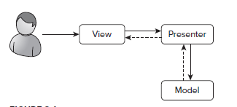
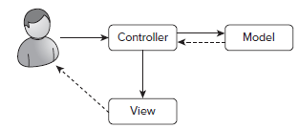
MVC Pattern
The Model-View-Controller Pattern separates an application into three main components: the model, the view, and the controller. The controller interacts with the model based on the requirements of the request. It renders the appropriate view and supplies it with the necessary data to display.
It’s a User Interface Pattern, therefore one of the many patterns you will use in a complex project.
MVP
MVC

Slide 35
MVC Pattern - Components
The model which contain or represent the data that users work with.
Views define how the application UI will be displayed.
Controllers process incoming requests, perform operations on the model and select views to render to the user.

Slide 36
MVC Pattern
Each piece of the MVC architecture is well-defined and self-contained, which is referred to as the separation of concerns .
The logic that manipulates the data in the model is contained only in the model;
The logic that displays data is only in the view
The code that handles user requests and input is contained only in the controller.
With a clear division between each of the pieces, your application will be easier to maintain and extend over its lifetime, no matter how large it becomes.

Slide 37
Models
Models—the M in MVC - contain the data that users work with.
There are two broad types of model:
view models - represent just data passed from the controller to the view,
domain models - which contain the data in a business domain, along with the operations, transformations, and rules for creating, storing, and manipulating that data, collectively referred to as the model logic .
Models are the definition of the universe your application works in.

Slide 38
Models
In a banking application, for example, the model represents everything in the bank that the application supports, such as accounts, the general ledger, and credit limits for customers, as well as the operations that can be used to manipulate the data in the model, such as depositing funds and making withdrawals from the accounts.
The model is also responsible for preserving the overall state and consistency of the data—for example, making sure that all transactions are added to the ledger and that a client doesn’t withdraw more money than he is entitled to or more money than the bank has.

Slide 39
Models
The model in an application built using the MVC pattern should
Contain the domain data
Contain the logic for creating, managing, and modifying the domain data
Provide a clean API that exposes the model data and operations on it
The model should not:
Expose details of how the model data is obtained or managed (in other words, details of the data storage mechanism should not be exposed to controllers and views)
Contain logic that transforms the model based on user interaction (because that is the controller’s job)
Contain logic for displaying data to the user (that is the view’s job)

Slide 40
Models
The benefits of ensuring that the model is isolated from the controller and views are that you can test your logic more easily and that enhancing and maintaining the overall application is simpler and easier.
Tip Many developers new to the MVC pattern get confused with the idea of including logic in the data model, believing that the goal of the MVC pattern is to separate data from logic. This is a misapprehension: the goal of the MVC pattern is to divide an application into three functional areas, each of which may contain both logic and data. The goal isn’t to eliminate logic from the model. Rather, it is to ensure that the model only contains logic for creating and managing the model data.

Slide 41
Controllers
Controllers are the connective tissue in the MVC pattern, acting as conduits between the data model and views. Controllers define actions that provide the business logic that operates on the data model and that provide the data that views display to the user.
A controller built using the MVC pattern should
Contain the actions required to update the model based on user interaction
The controller should not
Contain logic that manages the appearance of data (that is the job of the view)
Contain logic that manages the persistence of data (that is the job of the model)

Slide 42
Views
Views contain the logic required to display data to the user or to capture data from the user so that it can be processed by a controller action.
Views should:
Contain the logic and markup required to present data to the user
Views should not
Contain complex logic (this is better placed in a controller)
Contain logic that creates, stores, or manipulates the domain model

Slide 43
Views
Views can contain logic, but it should be simple and used sparingly. Putting anything but the simplest method calls or expressions in a view makes the overall application harder to test and maintain

Slide 44
ASP.NET Core MVC
ASP.NET MVC is a framework for building web applications that applies the general Model View Controller pattern to the ASP.NET framework.
In ASP.NET Core MVC, controllers are C# classes, usually derived from the Microsoft.AspNetCore.Mvc.Controller class.
Each public method in a class derived from Controller is an action method, which is associated with a URL.
When a request is sent to the URL associated with an action method, the statements in that action method are executed in order to perform some operation on the domain model and then to select a view to display to the client.

Slide 45
ASP.NET Core MVC

Slide 46
ASP.NET Core MVC
ASP.NET Core MVC uses a view engine , known as Razor, which is the component responsible for processing a view in order to generate a response for the browser. Razor views are HTML templates that contain C# logic that is used to process model data to generate dynamic content that responds to changes in the model.
ASP.NET Core MVC doesn’t apply any constraints on the implementation of your domain model. You can create a model using regular C# objects and implement persistence using any of the databases, objectrelational mapping frameworks, or other data tools supported by .NET.

Slide 47
Project Structure

Slide 48
Visual Studio Project Templates
Visual Studio offers several ASP.NET Core templates:
Empty
Web API
Web Application
Different authentication methods can be chosen.
Notes:
The Internet and Intranet Application templates offer a more complete starting point that already implements authentication mechanisms.

Slide 49
Visual Studio Project Templates

Slide 50
Visual Studio Project Templates
The Empty project template contains the plumbing for ASP.NET Core but doesn’t include the libraries or configuration required for an MVC application.
The Web API project template includes ASP.NET Core and MVC, with a sample application that demonstrates how to receive and process Ajax requests from clients.
The Web Application project template includes ASP.NET Core and MVC, with a sample application that demonstrates how to generate HTML content.
Note: The Web API and Web Application templates can be configured with different schemes for authenticating users and authorizing their access to the application.

Slide 51
Visual Studio Project Templates
The templates are just different starting points into the same functionality, and you can add whatever functionality you need to projects created with any of the templates.
So, the real difference between the project templates is the initial set of libraries, configuration files, code, and content that Visual Studio adds when it creates the project.
Regardless of the template that you use to create a project, there are some common folders and files that will appear. Some of the items in a project have special roles that are hard-coded into ASP.NET or MVC or one of the tools that Visual Studio provides support for. Others are subject to naming conventions that are used in most ASP.NET or MVC projects.

Slide 52
Visual Studio Project Structure
Folder or File | Description
/Areas | Areas are a way of partitioning a large application into smaller pieces.
/Dependencies | The Dependencies item provides details of all the packages a project relies on.
/Components | This is where view component classes, which are used to display selfcontained features such as shopping carts, are defined.
/Controllers | This is where you put your controller classes. This is a convention. You can put your controller classes anywhere you like, because they are all compiled into the same assembly.
Notes:
Filters?

Slide 53
Visual Studio Project Structure
Folder or File | Description
/Data | This is where database context classes should be defined, but they are also frequently defined in the Models folder.
/Migrations | This is where details of database schemas are stored so that deployment databases can be updated.
/Models | This is where you put your view model and domain model classes. This is a convention. You can define your model classes anywhere in the project or in a separate project.
Notes:
Filters?

Slide 54
Visual Studio Project Structure
Folder or File | Description
/Views | This directory holds views and partial views, usually grouped together in folders named after the controller with which they are associated.
/Views/Shared | This directory holds layouts and views that are not specific to a single controller.
Notes:
Filters?

Slide 55
Visual Studio Project Structure
Folder or File | Description
/Views/_ViewImports.cshtml | This file is used to specify the namespaces that will be included in Razor view files.
/Views/_ViewStart.cshtml | This file is used to specify a default layout for the Razor view engine.
/bower.json | This file is hidden by default. It contains the list of packages managed by the Bower package manager.
/project.json | This file specifies some basic configuration options for the project, including the NuGet packages it uses.
/Program.cs | This class configures the hosting platform for the application
Notes:
Filters?

Slide 56
Visual Studio Project Structure
Folder or File | Description
/Startup.cs | This class configures the application
/wwwroot | This is where you put static content such as CSS files and images. It is also where the Bower package manager installs JavaScript and CSS packages
Notes:
Filters?

Slide 57
Convention Over Configuration
There are two kinds of conventions in an MVC project:
The first kind is just suggestions as to how you might like to structure your project. For example, it is conventional to put the third-party JavaScript and CSS packages you rely on in the wwwroot/lib folder. This is where other MVC developers would expect to find them and where the package manager will install them. But you are free to rename the lib folder, or remove it entirely and put your packages somewhere else. That would not prevent MVC from running your application as long as the script and link elements in your views refer to the location you settle on.

Slide 58
Convention Over Configuration
The other kind of convention arises from the principle of convention over configuration , which was one of the main selling points that made Ruby on Rails so popular. Convention over configuration means that you don’t need to explicitly configure associations between controllers and their views, for example. You just follow a certain naming convention for your files, and everything just works. There is less flexibility in changing your project structure when dealing with this kind of convention.

Slide 59
Convention Over Configuration
By following a certain naming convention, everything “works”.
Principles
avoid configuring things that can be inferred;
all convention-based defaults can be overridden.
Example:
No need to explicitly configure associations between controllers and their views;

Slide 60
Convention Over Configuration
Three core directions:
Controllers;
Models;
Views.
Following common conventions and using a software design pattern facilitates code understanding even in large applications.

Slide 61
Controller Conventions
All controller classes end in “Controller” (ex: HomeController”);
Controllers are referenced only by the first part in their names;
New controller conventions can be created by implementing IControllerFactory.

Slide 62
View Conventions
Views and partial views should be located in the folder /Views/ControllerName.
ex: /Views/Home for the HomeController
The default view for an action should be named after that method.
ex: for an action Index, the view should be named Index.cshtml
Choosing the right view:
The default view will be used for: return View();
A different view can be specified by name: return View(“Other”);

Slide 63
Layout Conventions
Layout file names are prefixed with “_” (underscore);
Layouts are placed in the folder /Views/Shared/;
The default layout can be changed in _ViewStart.cshtml;
Specific layouts can be defined for every view:
ex: @{Layout = “~Views/Shared/_OtherLayout.cshtml”; }
Layouts can be disabled for a given view:
ex: @{Layout = null;}

Slide 64
A More Complex Project

Slide 65
Selecting the project type

Slide 66
Selecting the project template

Slide 67
Demo
https://github.com/liviucotfas/ase-web-and-cloud-applications-security/

Slide 68
Thank you!

